Slide 1
Revisiting Rollbacks on Smart Contracts in TEE-protected Private Blockchains
Systex 2024 workshop
Chen Chang Lew, ETH Zurich
Christof Ferreira Torres, ETH Zurich
Shweta Shinde, ETH Zurich
Marcus Brandenburger, IBM Research
8 July 2024
Notes:
Hallo, welcome everyone to my systex2024 workshop.
Today we are going to talk about rollback attacks. Rollback attack can be happened in many aspects.
But today, we are going to focus on smart contracts, to be precise, TEE-protected private blockchain.
For the credit, this work is done in IBM while I doing my master thesis.

Slide 2
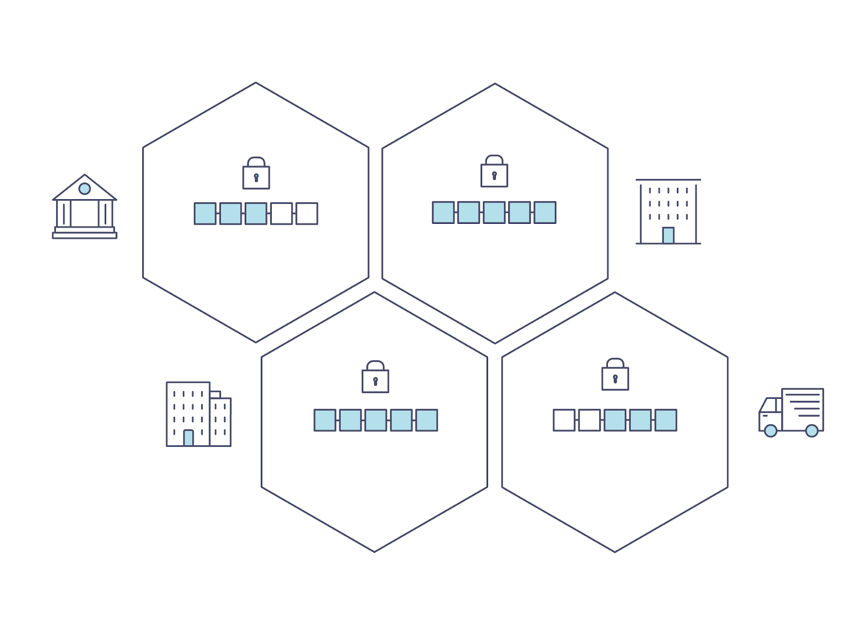
Privacy meets Blockchain
Shared, immutable ledger
Recording transactions and tracking assets
All transactions and data are visible and clear to participants
What if data are sensitive?
Hospital, clinic data
Research Institute
Company confidential data
How can we protect data privacy?
Modern cryptography
Homomorphic encryption, multi-party computation, zero-knowledge proof
Hardware-based Trusted execution
Trusted Execution Environment (TEE)
Notes:
Start with brief introduction, we start with Blockchain.
Blockchain is a shared, Immutable ledger that facilitates the process of recording transactions and tracking assets in a business network.
The inherent design of blockchain, where all transactions and data are visible to participants.
But what about some data that is sensitive, like the data in hospital, research institute, or company confidential data.
How can we protect the data privacy in blockchain?
There are some modern cryptography solution like homomorphic encryption, multi-party computation, zero-knowledge proof.
And other suggest maybe we can just use Hardware-based Trusted execution where we don’t have to implement the cryptography part because it is handled in Hardware.
In this talk we focus on a solution this.

Slide 3
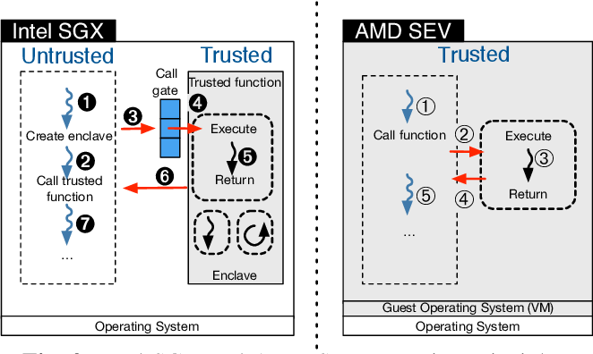
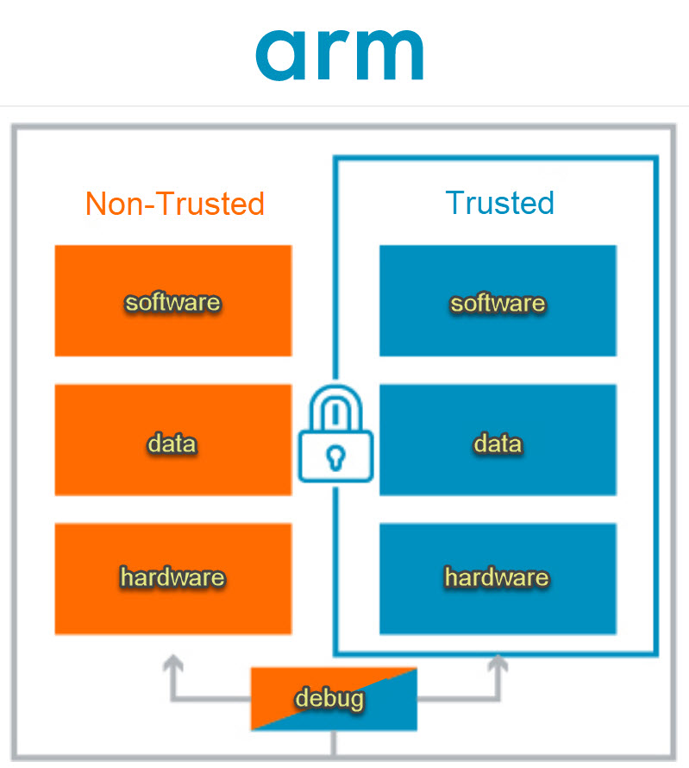
Introduction ~ Trusted Execution Environment (TEE)
Hardware-aided Isolation.
Which protects the code and data from unauthorized access or modifications
Data confidentiality
Execution integrity
Protected even against a malicious high privileged software (OS)
Remote Attestation
Example:
Intel SGX¹
AMD SEV²
ARM TrustZone³
¹https://www.intel.com/content/www/us/en/developer/tools/software-guard-extensions/overview.html
²https://www.amd.com/en/developer/sev.html
³https://www.arm.com/technologies/trustzone-for-cortex-m#:~:text=Arm%20TrustZone%20technology%20is%20used,Learn%20More
Notes:
Since in this workshop we already Show A lot of TEE properties in the previous section, so I guess we already have a pretty clear concept about TEE.
Just what need to highlight is all the data are now encrypted outside the TEE.
A trusted Execution Environment TEE is an isolated area in a main processor
Which protects the code and data from unauthorized access or modifications, and granted data confidentiality (the data will be encrypted in the memory) and execution integrity (where you are sure that the code is running is the one you expected)
And it can still be protected even with a malicious high priviledged software (operating system).
TEE environment provide some good security properties like remote attestation (where you can remotely verify or authenticate your code).
There are several implementation we have Intel SGX, AMD SEV and ARM trustzone.

Slide 4

Q: Does applying TEE solves the privacy problem of blockchain?
Notes:
So as the introduction from blockchain we know that all transactions and data are visible and clear to participants.
Our questions now become dose applying TEEs, really able solve the privacy problem of blockchain?

Slide 5
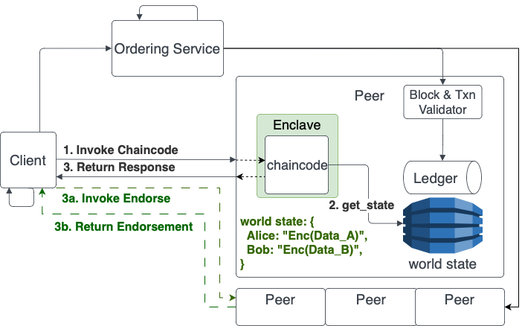

Fabric Private Chaincode
Hyperledger Fabric¹
An open-source permissioned blockchain framework
support for smart contracts in the form of chaincode
Fabric Private Chaincode (FPC)²
An extension that enables the execution of smart contracts in a secure enclave provided by TEEs
¹https://www.hyperledger.org/use/fabric
²https://github.com/hyperledger/fabric-private-chaincode
Notes:
In my research, I am more focus on the privacy protection scenario in Hyperledger Fabric and Fabric Private Chaincode.
Hyperledger Fabric is blockchain framework maintained mainly by IBM that allows for private permissioned blockchain
Where Fabric Private Chaincode (FPC) is an extenstion that enable of execution of smart contracts in a secure enclave provided by TEEs, such as intel SGX
Data are encrypted in memory and in the worldstate of the Peer.

Slide 6
Wait … maybe there is a problem …
Notes:
So back to our previous question, since all the data has been encrypted, does it solved the problem?
The answer is obvious, of course no, otherwise I wouldn’t here to research on this topic.
As acknowledged in the original FPC paper, there is a problem, which is rollback attack

Slide 7

Rollback Attack
Malicious peer can give back the old version of the encrypted data.
And this may break the confidentiality of the application.
Notes:
Although the data is encrypted,
Whenever the enclave is calling get state to get the information from the worldstate,
malicious peer can give back the old version the encrypted data and there is current no way that enclave can know the difference.
By using this method, it might potentially break the confidentiality of the system.
5 mins.

Slide 8
Contributions
Feasibility Analysis
Solution Prototyping and Implementation
Experimental Evaluation
Notes:
Based on all this, My contribution are as follows:
Feasibility Analysis: Demonstrate rollback attacks on FPC applications, Study existing approaches & evaluate feasibility in the context of FPC.
Solution Prototyping and Implementation: Single Key-Value Storage (SKVS), Trusted Ledger Enclave (TLE), Merkle Tree Approach (MTA).
Experimental Evaluation: Evaluate Security, Trusting Computing Base, Performance

Slide 9
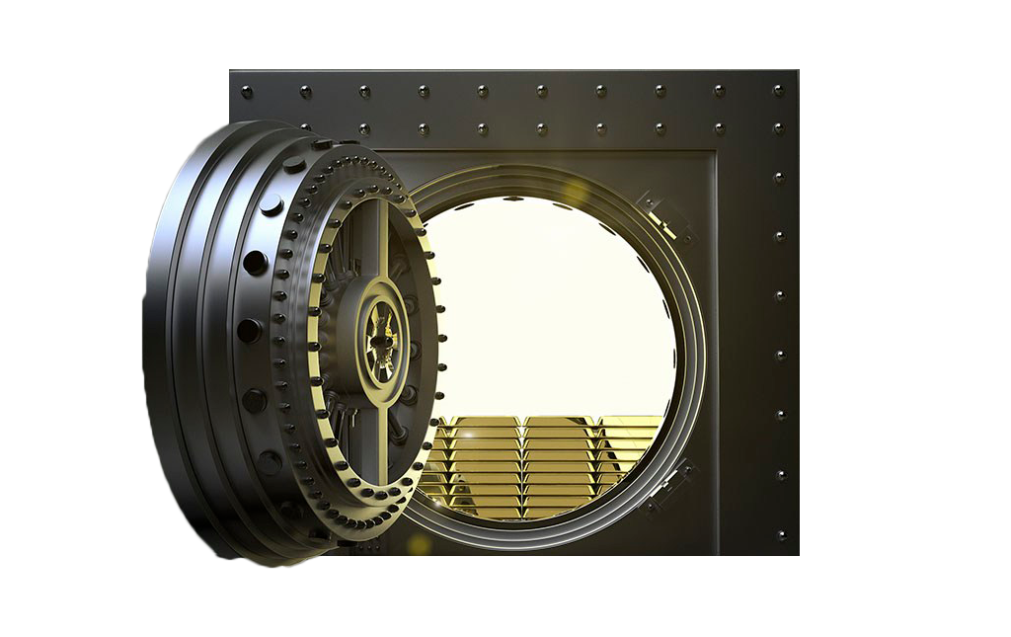


¹https://www.intel.com/content/www/us/en/developer/tools/software-guard-extensions/overview.html
²https://www.amd.com/en/developer/sev.html
³https://www.arm.com/technologies/trustzone-for-cortex-m#:~:text=Arm%20TrustZone%20technology%20is%20used,Learn%20More
Application: Secret Keeper Smart Contract
Enclave
Worldstate
Function:
Add User
Remove User
Lock New Secret
Reveal Secret
Authlist: [Alice]
Secret: Null
Alice
Bob
Notes:
In order to demonstrate rollback attack, we design an application, called Secret Keeper which is a smart contract,
that ack as a vault that store secret in it and also maintain an authorization list that allows to view or modify the secret.
User in the authorization list can either add new user, or modify and view the secret.
The worldstate is initiate with alice in the authlist and secret is null.

Slide 10
¹https://www.intel.com/content/www/us/en/developer/tools/software-guard-extensions/overview.html
²https://www.amd.com/en/developer/sev.html
³https://www.arm.com/technologies/trustzone-for-cortex-m#:~:text=Arm%20TrustZone%20technology%20is%20used,Learn%20More
Application: Secret Keeper Smart Contract
Enclave
Worldstate
Authlist: [Alice, Bob]
Secret: Secret_A
1. AddUser: Bob LockSecret: Secret_A
Alice
Bob

Slide 11
¹https://www.intel.com/content/www/us/en/developer/tools/software-guard-extensions/overview.html
²https://www.amd.com/en/developer/sev.html
³https://www.arm.com/technologies/trustzone-for-cortex-m#:~:text=Arm%20TrustZone%20technology%20is%20used,Learn%20More
Application: Secret Keeper Smart Contract
Enclave
Worldstate
Authlist: [Alice, Bob]
Secret: Secret_A
1. AddUser: Bob LockSecret: Secret_A
2. RevealSecret: Secret_A
Alice
Bob

Slide 12
¹https://www.intel.com/content/www/us/en/developer/tools/software-guard-extensions/overview.html
²https://www.amd.com/en/developer/sev.html
³https://www.arm.com/technologies/trustzone-for-cortex-m#:~:text=Arm%20TrustZone%20technology%20is%20used,Learn%20More
Application: Secret Keeper Smart Contract
Enclave
Worldstate
Authlist: [Alice]
Secret: Secret_B
1. AddUser: Bob LockSecret: Secret_A
2. RevealSecret: Secret_A
3. RemoveUser: Bob LockSecret: Secret_B
Alice
Bob

Slide 13

¹https://www.intel.com/content/www/us/en/developer/tools/software-guard-extensions/overview.html
²https://www.amd.com/en/developer/sev.html
³https://www.arm.com/technologies/trustzone-for-cortex-m#:~:text=Arm%20TrustZone%20technology%20is%20used,Learn%20More
Application: Secret Keeper Smart Contract
Enclave
Worldstate
Authlist: [Alice]
Secret: Secret_B
1. AddUser: Bob LockSecret: Secret_A
2. RevealSecret: Secret_A
3. RemoveUser: Bob LockSecret: Secret_B
4. RevealSecret: (Failed)
Alice
Bob
Demo: https://www.loom.com/share/e3dca62f8df849229e2c6414fd374289?sid=473acda1-92ac-4ad6-89c4-ddb2f5786dd5
Notes:
We have some demonstration video available in the paper and also here in the link.
But due to time constraint we will not show the video today, but feel free to have a chat during lunch to get more details.

Slide 14
Rollback Attack! Secret Keeper
Action
Alice (Lock) 🡪 Secret A
AuthList Secret
[Alice, Bob] Secret A
Notes:
Now we are going to show you how can we break the confidentiality of this system using rollback attack.

Slide 15
Rollback Attack! Secret Keeper
Action
Alice (Lock) 🡪 Secret A
Bob (Reveal) 🡪 (Success)
AuthList Secret
[Alice, Bob] Secret A
[Alice, Bob] Secret A

Slide 16
Rollback Attack! Secret Keeper
Action
Alice (Lock) 🡪 Secret A
Bob (Reveal) 🡪 (Success)
Alice (Remove) 🡪 Bob
AuthList Secret
[Alice, Bob] Secret A
[Alice, Bob] Secret A
[Alice] Secret A

Slide 17
Rollback Attack! Secret Keeper
Action
Alice (Lock) 🡪 Secret A
Bob (Reveal) 🡪 (Success)
Alice (Remove) 🡪 Bob
Alice (Lock) 🡪 Secret B
AuthList Secret
[Alice, Bob] Secret A
[Alice, Bob] Secret A
[Alice] Secret A
[Alice] Secret B

Slide 18
Rollback Attack! Secret Keeper
Action
Alice (Lock) 🡪 Secret A
Bob (Reveal) 🡪 (Success)
Alice (Remove) 🡪 Bob
Alice (Lock) 🡪 Secret B
Bob (Reveal) 🡪 (Success)
AuthList Secret
[Alice, Bob] Secret A
[Alice, Bob] Secret A
[Alice] Secret A
[Alice] Secret B
[Alice, Bob] Secret B
Demo: https://www.loom.com/share/e540bf6395f94ab8ba547bd43942d063?sid=b32de7ea-e5d7-43ef-9e06-bf11b3cfc6ff
Notes:
As you can see the real problem is the key version mismatch problem that actually break the confidentiality of the system.

Slide 19
Q: How can we overcome this issue?

Slide 20
Related Work & Analysis
Solution for rollback attack on TEE
Monotonic Counter¹
ROTE²
Enclave DB³
Not Suitable In FPC
¹https://www.google.com/url?sa=t&rct=j&q=&esrc=s&source=web&cd=&ved=2ahUKEwjb8I3dr8D_AhVe_7sIHTj3BhgQFnoECAcQAQ&url=https%3A%2F%2Fcdrdv2-public.intel.com%2F671564%2Fintel-sgx-platform-services.pdf&usg=AOvVaw3Cbr31cwfEXIgDGYZoXsgr
²Sinisa Matetic et al. “ROTE: Rollback Protection for Trusted Execution”. In: Pro- ceedings of the 26th USENIX Conference on Security Symposium. SEC’17. https://www.usenix.org/conference/usenixsecurity17/technical-sessions/presentation/matetic
³C. Priebe, K. Vaswani, and M. Costa, “EnclaveDB: A Secure Database Using SGX,” in Proc. IEEE Symposium on Security and Privacy (SP), 2018. https://ieeexplore.ieee.org/document/8418608
Notes:
We have research on several solution for rollback attack on TEE, for example monotonic counter, rote and enclave DB.
However, these solution are not suitable in the context of FPC.

Slide 21


Strawman approach: Single Key Value Storage (SKVS)
We only store a single key in KVS
Advantages:
Naive to Implement.
Disadvantages:
Performance drop as the application state gets larger
Concurrent transactions result in conflicts (which may impact performance badly)
Instead of doing this,
Data in worldstate:
{
“Alice”: “Enc Alice’s data”,
“Bob”: “Enc Bob’s data”,
}
We do this,
Data in worldstate:
{
“Data”: {
“Encrypted of both alice & bob objects”
}
}
Notes:
But actually there already have some existing solution.
Recall back to the previously attack, the real problem is about the version mismatch of during key value pair.
as the application state gets larger (explain ... that may be unneeded data is already loaded into the enclave AND ... concurrent transactions result in conflicts ... which may impact performance badly

Slide 22
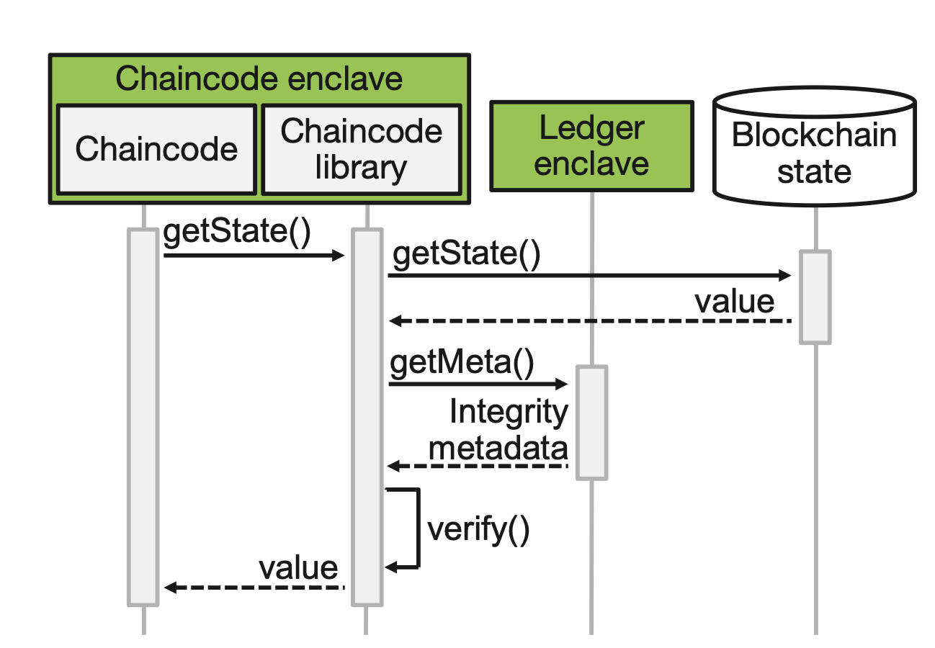
Trusted Ledger Enclave (TLE)¹
Having an extra enclave to track the ledger and store the integrity metadata of the KVS.
Advantages:
O(1) verification on KVS
Disadvantages:
Original FPC's v1.0 RPC didn't implement due to maintenance difficulties.
¹M. Brandenburger, C. Cachin, R. Kapitza and A. Sorniotti, "Trusted Computing Meets Blockchain: Rollback Attacks and a Solution for Hyperledger Fabric," 2019 38th Symposium on Reliable Distributed Systems (SRDS), Lyon, France, 2019, pp. 324-32409, doi: 10.1109/SRDS47363.2019.00045. ²https://www.edgeless.systems/products/ego/
Notes:
In the original FPC paper, they also introduce another solution call trusted ledger enclave TLE.
Where they add an extra enclave to track the ledger and store the metadata of the KVS.
However,

Slide 23

Our Approach
Notes:
Can we do something better. Easy to use and maintain

Slide 24
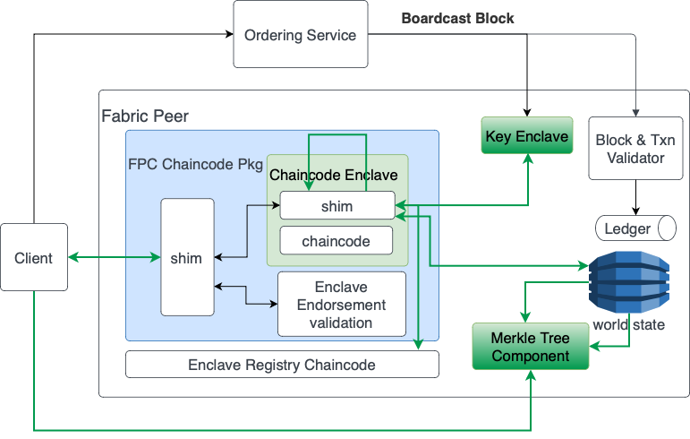
Merkle Tree Approach (MTA) Architecture
Verify Merkle Path
Update & query :
O(log n) (n = # of data)
Invoke Chaincode:
O(m) (m = # of peers)
Require Merkle Root from all peers before invoke chaincode
Invoke CC with Merkle Root
Get State -> Value + MPath
Query for Merkle Root
Update Merkle Component
Notes:
That bring us to our solution,
New Component Merkle Tree Compoenent & Key Enclave. Label as Green Color in the picture.
Upon Ledger update, update Merkle Tree
get_state() return data + merkle path

Slide 25
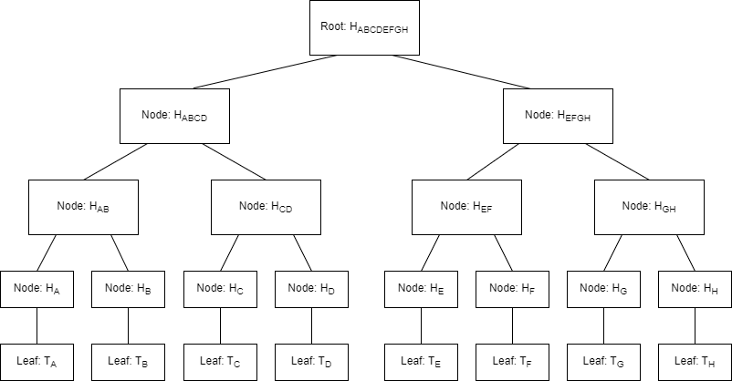
How we maintain the merkle tree
Each Leaf contain Each Key Value Pair from wordstate.
During Get State, Return Leaf + related Merkle Path
Notes:
Lets see how its compare to other solution.

Slide 26
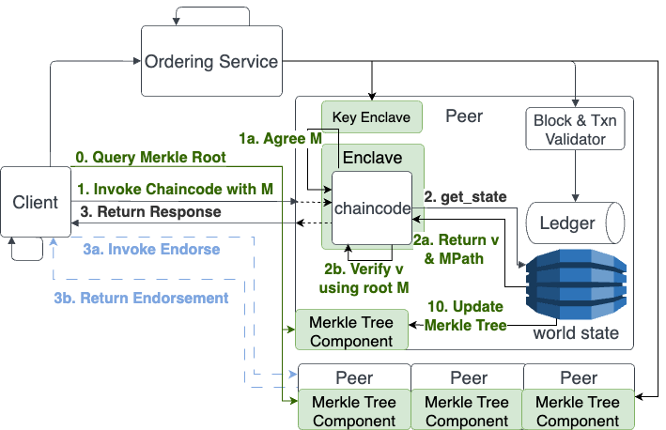
MTA Execution Flow
Addition Step:
(0. Query Merkle Root)
(1a. Agree Merkle Root)
(2b. Verify value)
(10. Update Merkle Tree)
Modify Step:
(1. Invoke CC with M)
(2a. Return Value & MPath)
Notes:
Before client invoke CC, need to query multiple peers for latest Merkle Roots
Client invoke CC with all the Merkle Roots as parameter
ECC use Key enclave to verify signature and choose majority Merkle Root “M”
For every get_state() check data+MerklePath => MerkleRoot
When a malicious peer try to return an outdated version of value, the enclave will able to detect it since the merkle path will not compute to the same merkle root.
We have some demonstration video available in the paper and also here in the link.

Slide 27

Evaluation
Trusting Computing Base (TCB) Size
Performance Impact
Security Analysis
Notes:
Lets see how our solution compare to other solution.

Slide 28
Trusting Computing Base (TCB)
 | Own Enclave component (inside TCB) | Enclave STUB (Inside TCB) | Client SDK (Outside TCB) | Fabric Peer (Outside TCB)
SKVS | 0 | 141 | 0 | 0
TLE | 6700+ | 162 | 0 | 0
Merkle | 0 | 534 | 105 | 2000+
Shows how many lines of code (LoCs) added for each solution

Slide 29
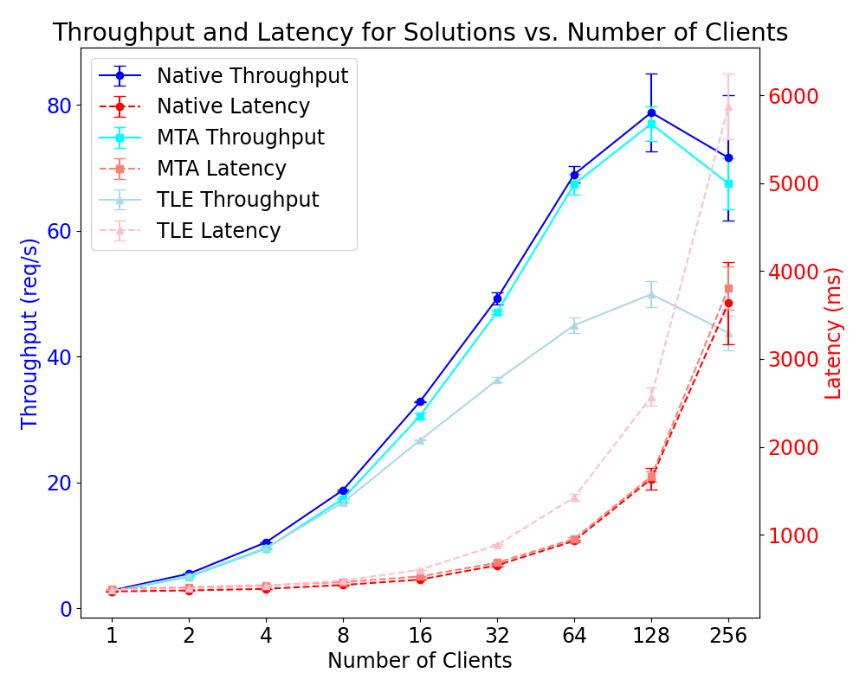
Test on # of clients.
(Expectation: Client++, Throughput++)
All Solution reach saturation at 128 client
MTA perform just as good as Native FPC
TLE perform decrease as faster as the # of client increase
Notes:
In this experiment we have MTA and TLE compare to the Native.
Setting: 2 peers, R:W = 50:50, Test for different # of clients (1,2,4,8,16,32,64,128,256), MaxTxnPerBlock = # client

Slide 30
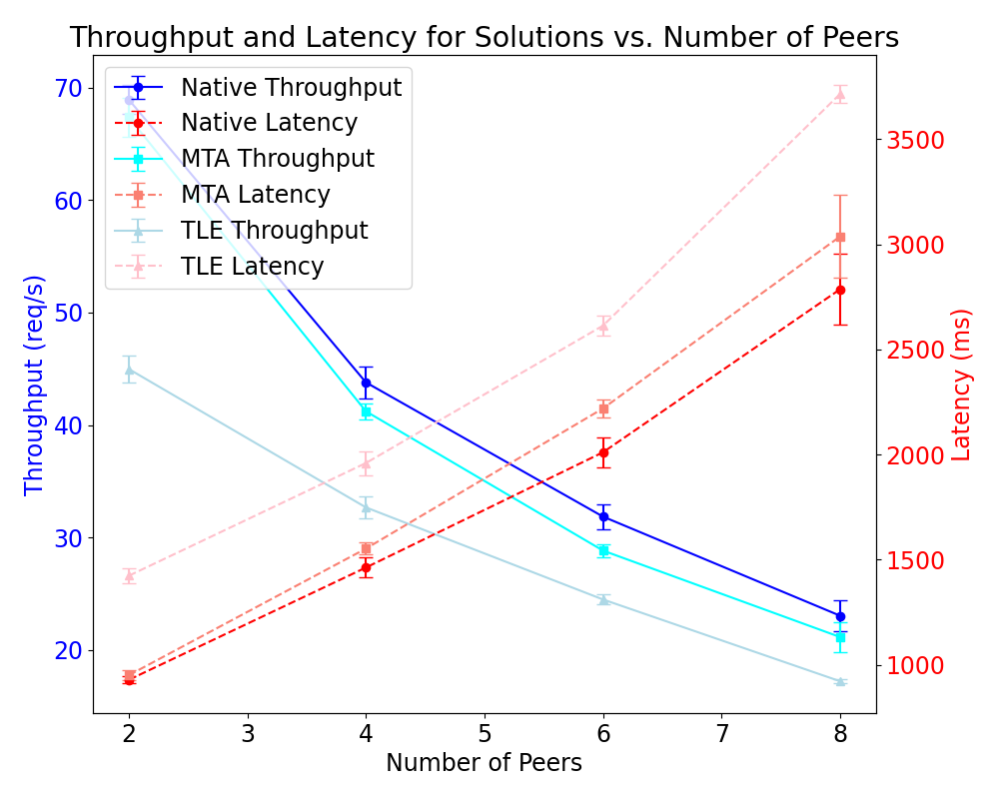
Test on # of peers.
(Expectation: Peers++, Latency++, MTA will become worst)
Native: linear latency increase
MTA: superlinear latency increase. (because we query each peer 1-by-1)
TLE: Still perform the worst
Notes:
Setting: R:W = 50:50, MaxTxnPerBlock = # client = 64, RTT delay: 15ms, Test for peers = 2,4,6,8

Slide 31
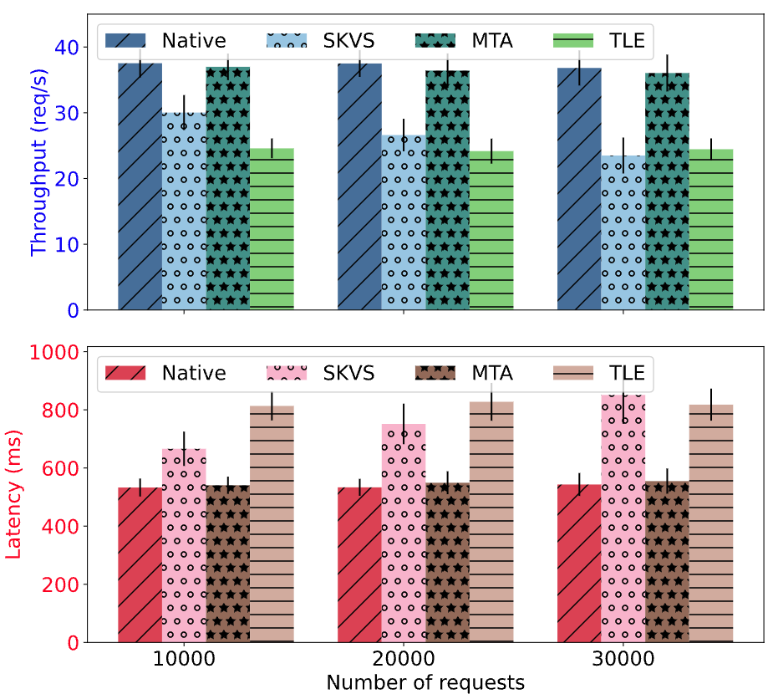
Test on Ext Secret Keeper
MTA: perform as good as Native
TLE: has the worst performance
SKVS: performance drop as txn number increase
Read & Write the whole data for each action.
More Data -> More Time to decrypt & encrypt
Notes:
And now we design another Scenario where we want to simulate real world application.
Setting: Use ExtSecretKeeper Chaincode, Test for SKVS & Merkle & TLE
R:W = 95:5, MaxTxnPerBlock = # client = 20
One client send write others read, RTT delay: 15ms
Run for 30000 request & record their throughput for each 10000 request
SKVS: performance drop as txn number increase, This is because each read and write will read all the data together, As total data store in worldstate getting larger, skvs require more time to enc & decrypt for each request

Slide 32
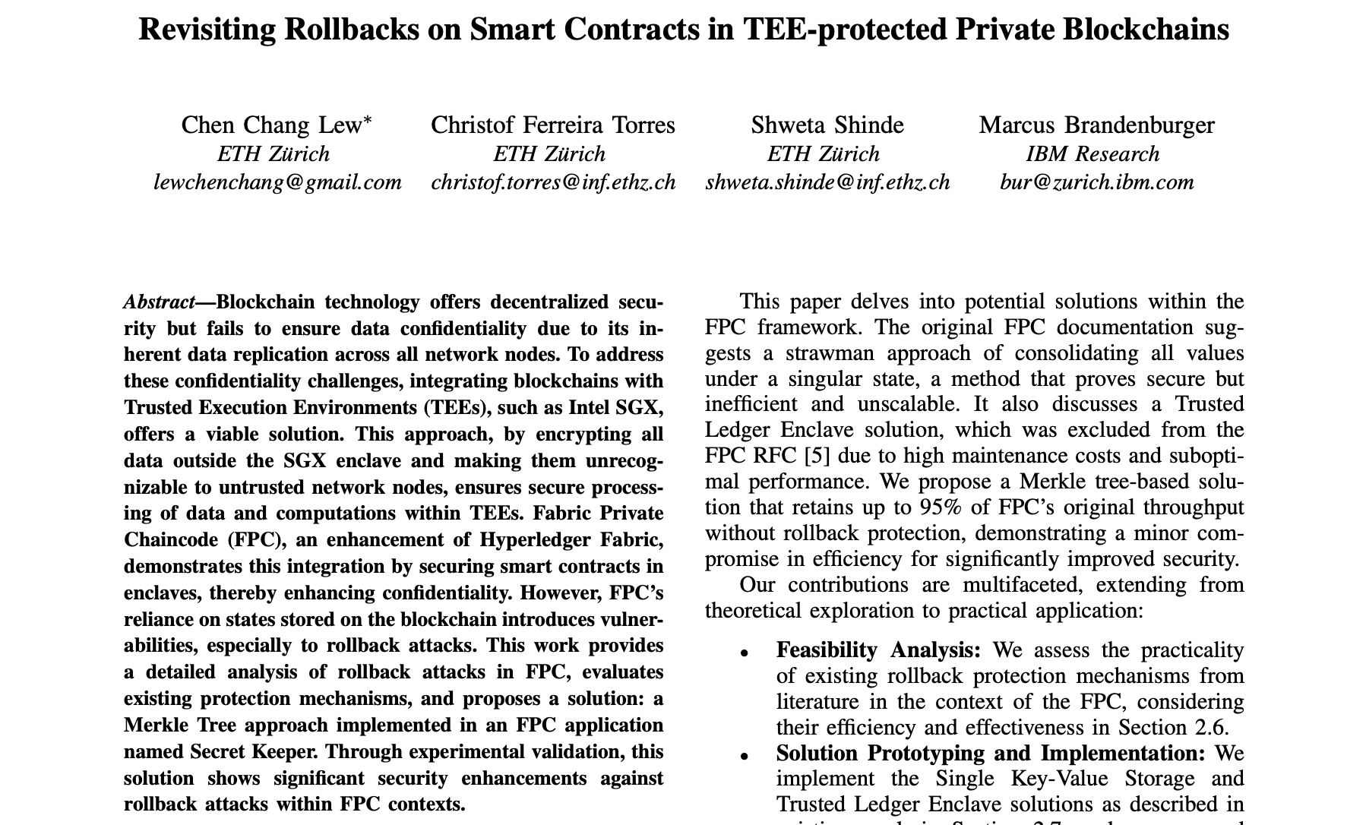
Full Article¹
¹https://github.com/chenchanglew/systex2024/blob/2bd229b4d4c4e6be9648c411aa8e4d744eff3524/systex24-final56.pdf
Notes:
And here just an advertisement, If you are interested into more details, feel free to read our paper. Which is now available on github.

Slide 33
Lessons Learned
Solutions | Advantages | Disadvantages | Comment
SKVS | - Small TCB (141 LoC) - Easy to implemented - no Fabric Peer’s Modification | - Bad performance in concurrent transactions - Always load all data in the enclave | - Good for application dependent on High Read Operation.
TLE | - Transparent for the clients. - In theory good performance (O(1) for retrieve & update) | - Mediocre Performance (peak 65% of Native FPC) - Need to edit Fabric Peer’s code - Relatively large TCB (6000+, plus fabric peer code) | - Good for integrate with old system. (Just require to update the chaincode)
MTA | - Small TCB (500+ LoC) - Great Performance (95% of Native FPC) | - Need to edit Fabric Peer's code - Need to edit Client side SDK - Cannot integrate with old system. | - Good for new application that require rollback protection.

Slide 34

Thanks!
Artifact links (feel free to play around and break it XD)

Slide 35
Reference Slides
Intel SGX: https://www.intel.com/content/www/us/en/developer/tools/software-guard-extensions/overview.html
AMD SEV: https://www.amd.com/en/developer/sev.html
ARM Trustzone: https://www.arm.com/technologies/trustzone-for-cortex-m#:~:text=Arm%20TrustZone%20technology%20is%20used,Learn%20More
Hyperledger Fabric: https://www.hyperledger.org/use/fabric
Fabric Private Chaincode: https://github.com/hyperledger/fabric-private-chaincode
SGX Monotonic counters: https://www.google.com/url?sa=t&rct=j&q=&esrc=s&source=web&cd=&ved=2ahUKEwjb8I3dr8D_AhVe_7sIHTj3BhgQFnoECAcQAQ&url=https%3A%2F%2Fcdrdv2-public.intel.com%2F671564%2Fintel-sgx-platform-services.pdf&usg=AOvVaw3Cbr31cwfEXIgDGYZoXsgr
ROTE: Sinisa Matetic et al. “ROTE: Rollback Protection for Trusted Execution”. In: Pro- ceedings of the 26th USENIX Conference on Security Symposium. SEC’17. Vancouver, BC, Canada: USENIX Association, 2017, pp. 1289–1306. isbn: 9781931971409. https://www.usenix.org/conference/usenixsecurity17/technical-sessions/presentation/matetic
Trusted Ledger Enclave (TLE): M. Brandenburger, C. Cachin, R. Kapitza and A. Sorniotti, "Trusted Computing Meets Blockchain: Rollback Attacks and a Solution for Hyperledger Fabric," 2019 38th Symposium on Reliable Distributed Systems (SRDS), Lyon, France, 2019, pp. 324-32409, doi: 10.1109/SRDS47363.2019.00045. https://ieeexplore.ieee.org/document/9049585
Formal Verification: ¹Saharsh Agrawal and Karen Tu. “Enabling Verifiable Execution of Distributed Secure Enclave Platforms”. In Berkeley EECS-2021-153, https://www2.eecs.berkeley.edu/Pubs/TechRpts/2021/EECS-2021-153.html
Merkle Tree: https://en.wikipedia.org/wiki/Merkle_tree

Slide 36
HIDING PAGE FROM HERE

Slide 37
Demo Solution
SKVS
MTA
TLE

Slide 38
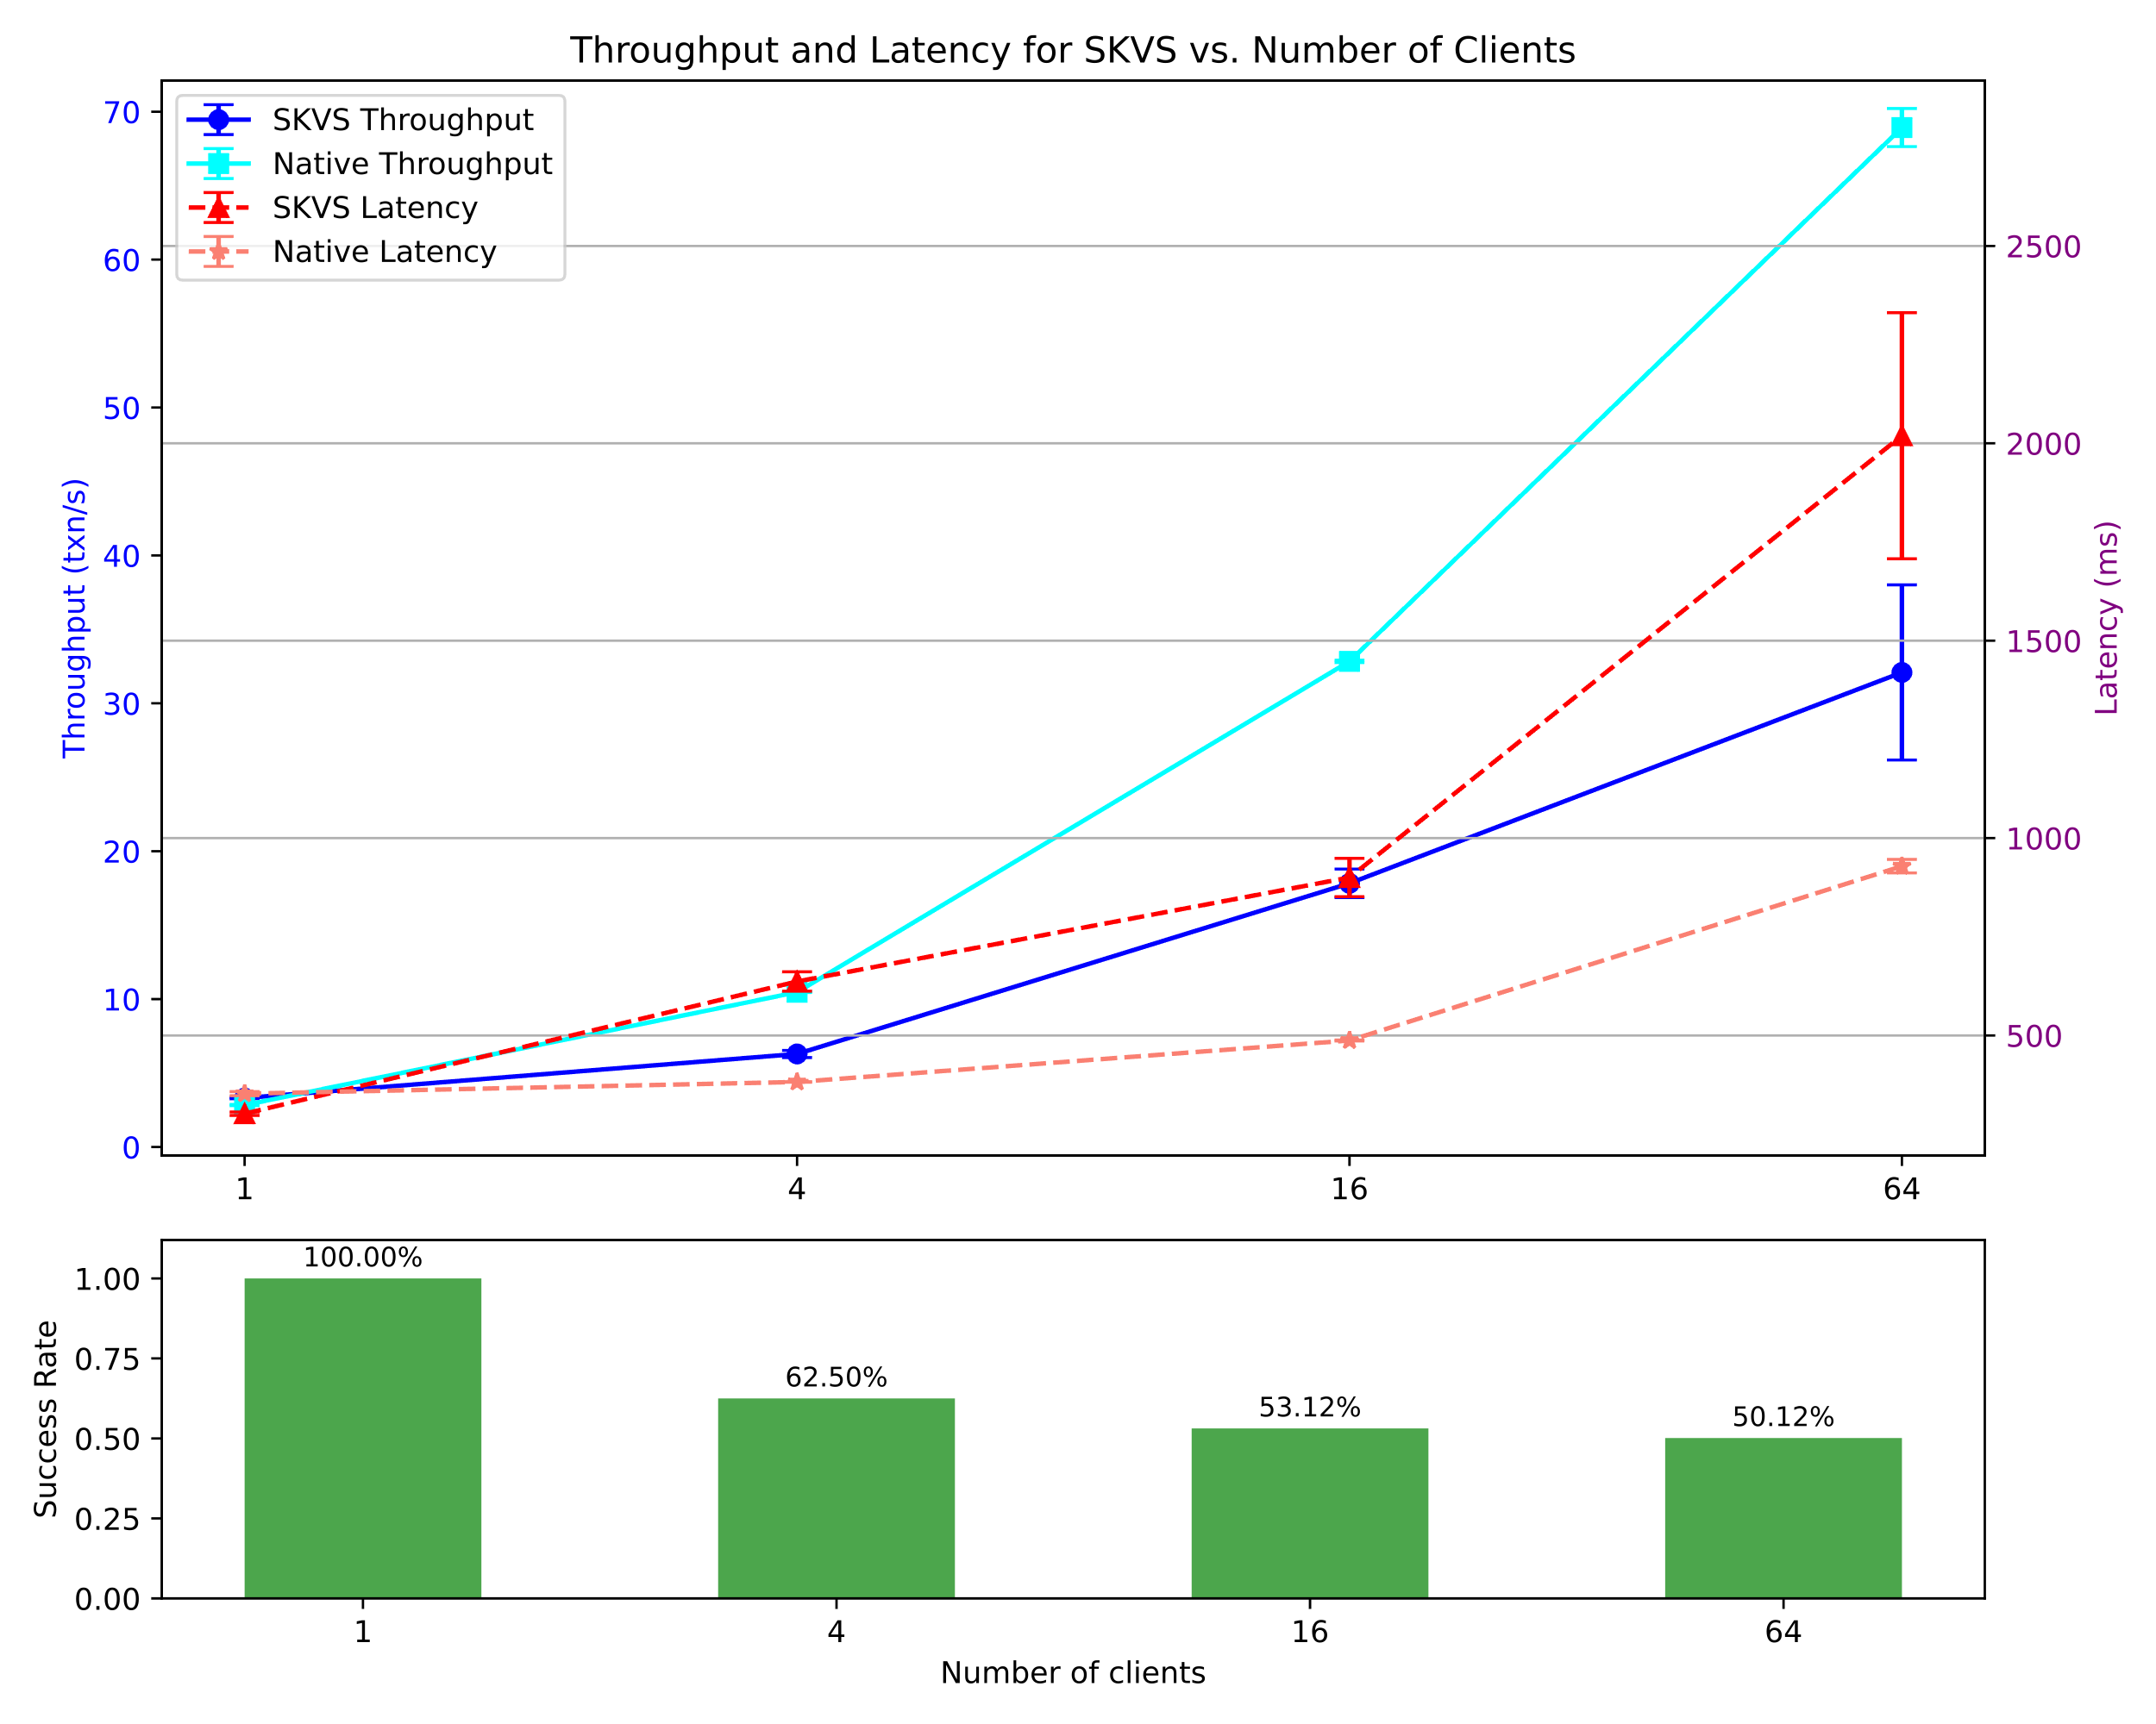
Micro: Test on if SKVS RW conflict affect throughput & success rate. (Expectation: Client++, Success Rate--, Bad Throughput)
Setting
Use KVS Chaincode
2 peers
Test for different # of clients (1,4,16,64)
MaxTxnPerBlock = # client
R:W = 50: 50
Explain result:
All read Txn will always success
After one write txn the rest read txn in the same block will be rejected
Rejected txn slowed down the throughput a lot

Slide 39
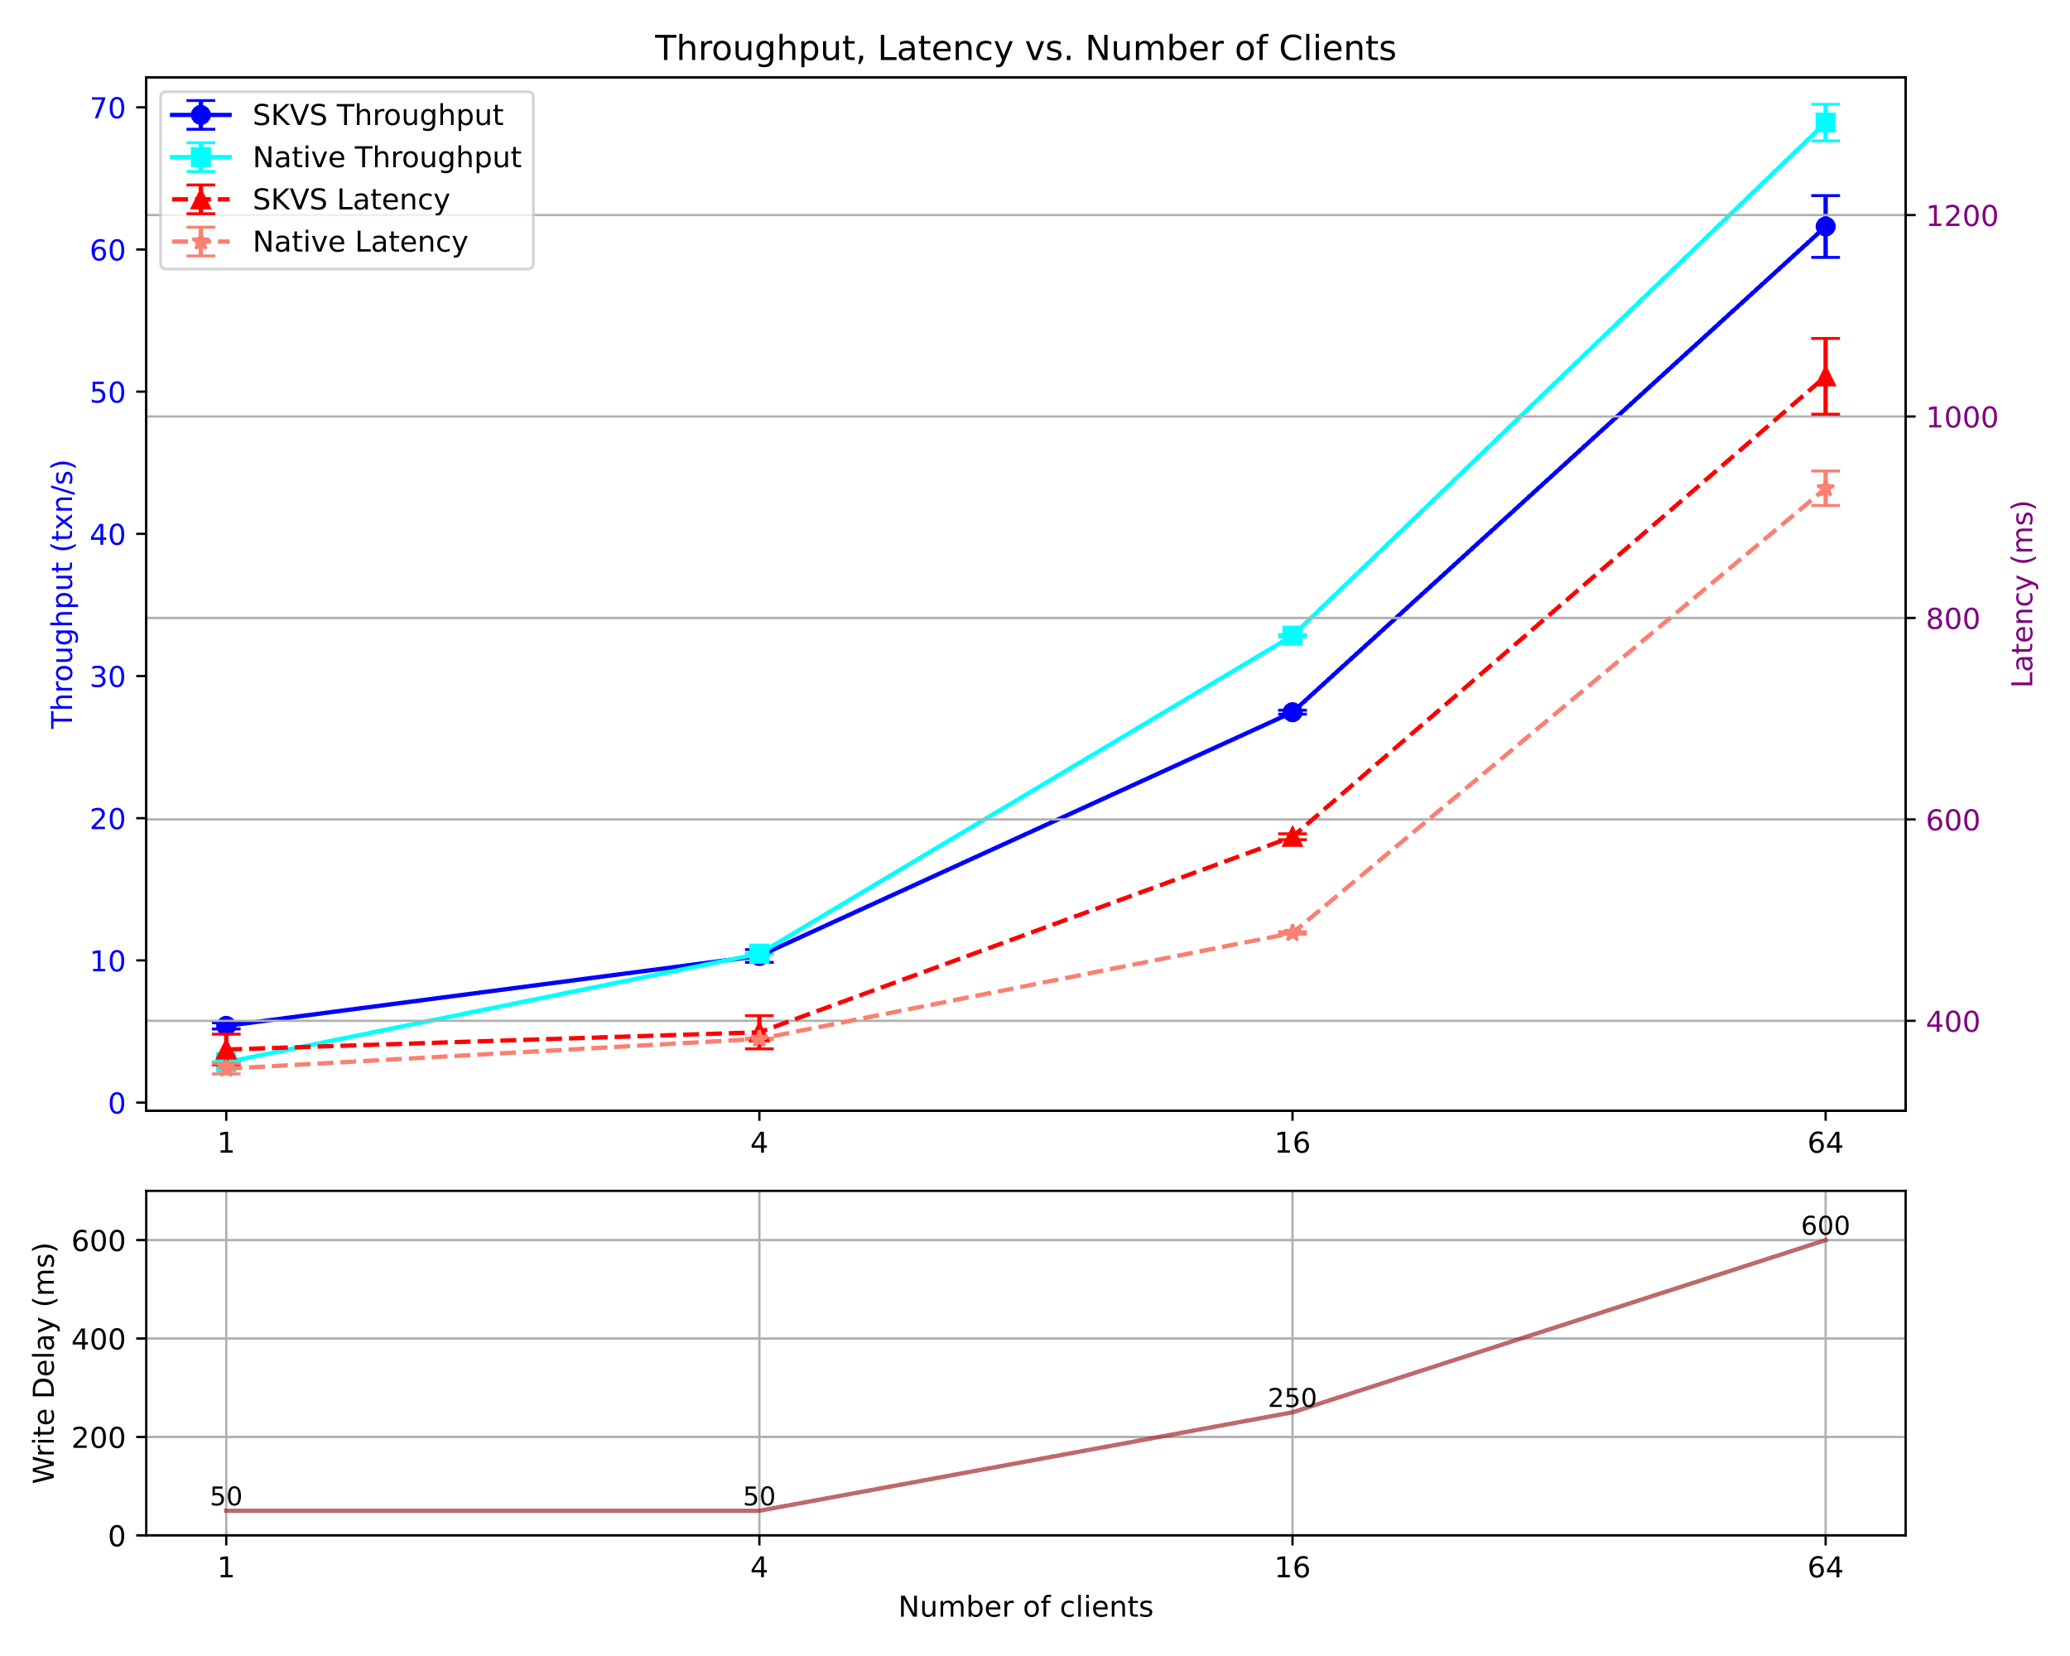
Micro: Test on if SKVS RW conflict affect the throughput (no conflict) (Expectation: Client++, Throughput++, Good Throughput)
Setting
Use KVS Chaincode
2 peers
Test for different # of clients (1,4,16,64)
MaxTxnPerBlock = # client
R:W = #client-1 : 1
Need to add a write delay to write client make sure the write txn is sent at the last txn in the block
Delay is the optimal delay by test
Explain result:
Performance way better when there is no conflicts

Slide 40
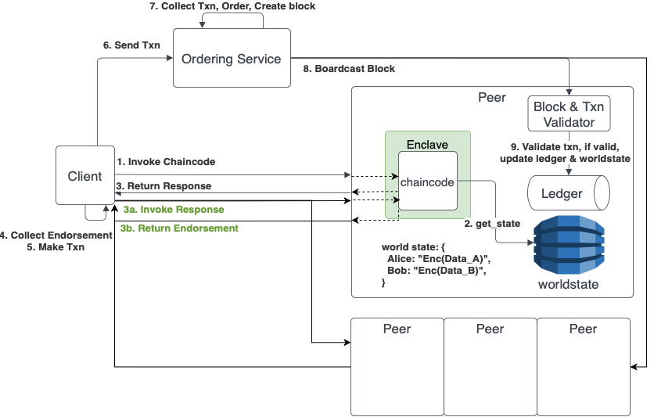
Attack # 2
If we have an access control list where who is allow to execute the chaincode.
Malicious peer can allow outdated client to access the data.
Notes:
Here come another scenario where we have an access control list where who is allow to execute the chaincode,
So malicious peer can allow outdated client to access the data.
You should say that this problem was already acknowledged by the authors in the original FPC paper ...

Slide 41
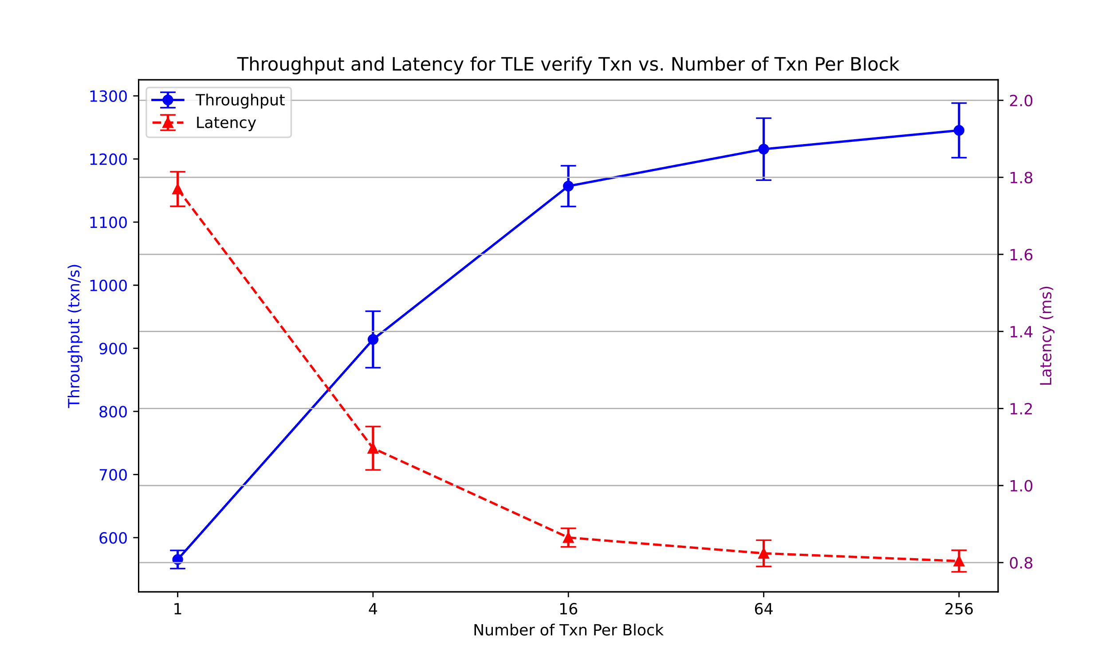
Micro: Test on each added function ~ TLE (Expectation: TxnPerBlock++, Throughput++)
Setting
Use KVS Chaincode
Test on how much time TLE enclave verify each transactions. (Just verify)
Test for different # of clients (1,4,16,64,256)
MaxTxnPerBlock = # client
Explain result:
Latency < 1/20 of Original FPC, since it is just verify txn only
Which means the time of processing Txn in TLE is negligible.

Slide 42
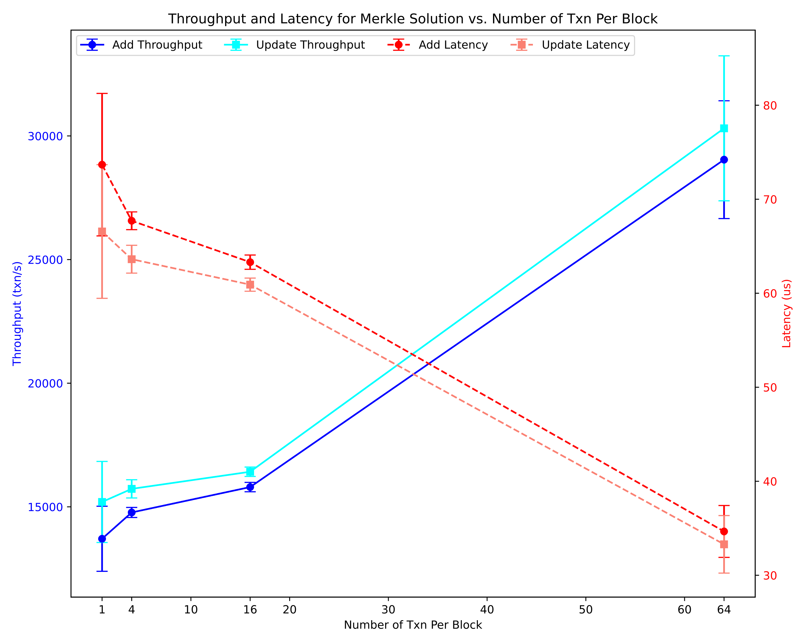
Micro: Test on each added function ~ Merkle (Expectation: TxnPerBlock++, Throughput++)
Setting
Use KVS Chaincode
Test on how much time Merkle Component add & update each txn to merkle tree.
Test for different # of clients (1,4,16,64)
MaxTxnPerBlock = # client
Explain result:
Update a key slightly faster than adding a new key
Latency < 1/400 of Native FPC, thus latency bring by merkle component update is small

Slide 43
Future Works
Evaluate our solutions in real distributed network settings
Integrate our solutions with upstream FPC
Exploring rollback protections for various TEEs (other than Intel SGX) within the FPC framework
Support features in FPC provided by Hyperledger Fabric
range queries by key
private data collection
Exploring our solutions in other blockchain frameworks that utilize TEEs and relies on externally sotred states or lacks secure storage.

Slide 44
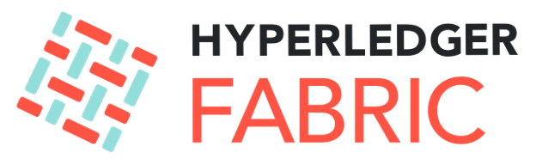
Fabric Private chaincode
Hyperledger Fabric¹
An open-source permissioned blockchain framework with support for smart contracts in the form of chaincode
Offers developers to write chaincodes in different programming languages, including Go, Node.js, and Java
Fabric Private Chaincode (FPC)²
An extension that enables the execution of smart contracts in a secure enclave provided by TEEs, such as Intel SGX
Data is encrypted whenever outside the enclave, ex: in memory and also on the ledger, particular, the Worldstate of the peers (Worldstate is a key-value storage KVS)
¹https://www.hyperledger.org/use/fabric
²https://github.com/hyperledger/fabric-private-chaincode
Notes:
In my research, I am more focus on the privacy protection scenario in Hyperledger Fabric and Fabric Private Chaincode.
Hyperledger Fabric is blockchain framework maintained mainly by IBM that allows for private permissioned blockchain
Where Fabric Private Chaincode are an extenstion that enable of execution of smart contracts in a secure enclave provided by TEEs, such as intel SGX
Data are encrypted in memory and in the worldstate of the Peer.

Slide 45

Fabric Private Chaincode - Architecture
Threat Model:
Enclave is trusted
Malicous Peer control every input and output from enclave chaincode
Client can be malicious
Notes:
So we say, how about let’s add TEE to our chaincode. In this model we didn’t use secure storage while all the data is saved and encrypted in the worldstate.
Now the data in the Key value storage is encrypted and only the enclave have the decryption key to unlock the data.

Slide 46
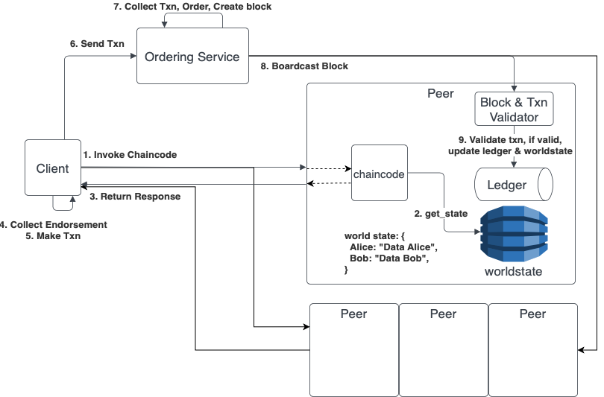
Hyperledger Fabric - Architecture
Threat Model:
Ordering service is trusted
Majority of Peers are correct
Client can be malicious
Notes:
Lets have a quick architecture view on Hyperledger Fabric.
Fabric divided into three part, the client side, ordering service and the peer.
Each peer host the smart contract aka Chaincode in their side and also record the ledger and the worldstate. The wordstate is a kvs.
This picture provide the flow how a txn was made. At first the client will send the invoke chaicode request to the chaincode, then the chaincode will get some data from worldstate via get_state,
and once the chaincode execution was done, it will send the response back to the client, when client collect enough endorsement,…
In this model we assume that the majority of peer are correct that the malicious peer are not able to create false result because it is not a majority.
However, This will only protect the Integrity of the execution but the data inside the chaincode is not protected.
So, How can we solve this?

Slide 47
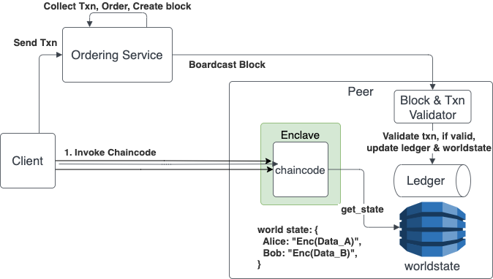

Monotonic counters¹
A monotonic counter is a persistent, increment-only value that maintains its state even after the system reboots
Will not capable because every execution of FPC is just a simulation that the client can decide not to submit the transaction.
¹https://www.google.com/url?sa=t&rct=j&q=&esrc=s&source=web&cd=&ved=2ahUKEwjb8I3dr8D_AhVe_7sIHTj3BhgQFnoECAcQAQ&url=https%3A%2F%2Fcdrdv2-public.intel.com%2F671564%2Fintel-sgx-platform-services.pdf&usg=AOvVaw3Cbr31cwfEXIgDGYZoXsgr
Notes:
Mention advatages and disadvantages

Slide 48
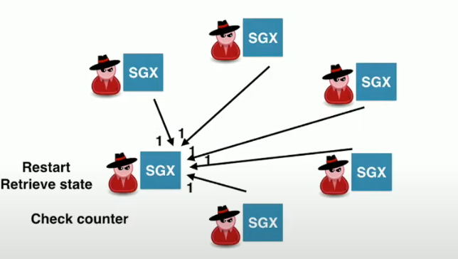
ROTE: Rollback Protection for Trusted Execution¹
ROTE achieve data consistent using distributed system, where multiple SGX enclaves communicate with each other to establish a consistent view
It is not trivial because in FPC we might not want the communicate between peers
¹Sinisa Matetic et al. “ROTE: Rollback Protection for Trusted Execution”. In: Pro- ceedings of the 26th USENIX Conference on Security Symposium. SEC’17. Vancouver, BC, Canada: USENIX Association, 2017, pp. 1289–1306. isbn: 9781931971409.
https://www.usenix.org/conference/usenixsecurity17/technical-sessions/presentation/matetic
Notes:
Protocol approach where multiple sgx ,,
And there are
Is not necessary trivial for FPC because we might not able to communicate between peers.
Mention advantages and disadvantages

Slide 49



Formal Verification¹
Nice and orthogonal approach
But is very application dependent (because we need to translate the application logic, E.g., tamarin model)
Might not be able to solve general cases
¹Saharsh Agrawal and Karen Tu. “Enabling Verifiable Execution of Distributed Secure Enclave Platforms”. In Berkeley EECS-2021-153, https://www2.eecs.berkeley.edu/Pubs/TechRpts/2021/EECS-2021-153.html

Slide 50
Merkle Tree¹
Properties that are useful
Integrity Verification
Incremental Updates
Scalability
Proof of membership
¹https://en.wikipedia.org/wiki/Merkle_tree
Notes:
Integrity Verification: A Merkle tree allows for efficient and secure verification of data integrity. By computing and comparing hash values, it ensures that data stored in the tree has not been tampered with or modified.
Incremental Updates: Merkle trees support incremental updates, allowing for efficient updates or additions to the dataset.
Scalability: Merkle trees can handle large datasets efficiently.
Proofs of Membership: Merkle trees enable the creation of proofs of membership. These proofs allow anyone to verify that a specific data element is part of the tree without revealing the entire dataset.

Slide 51
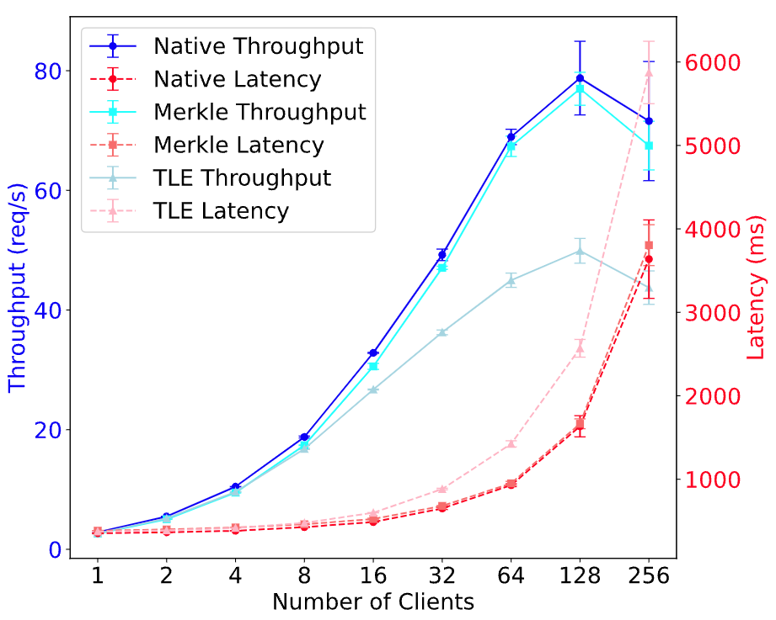
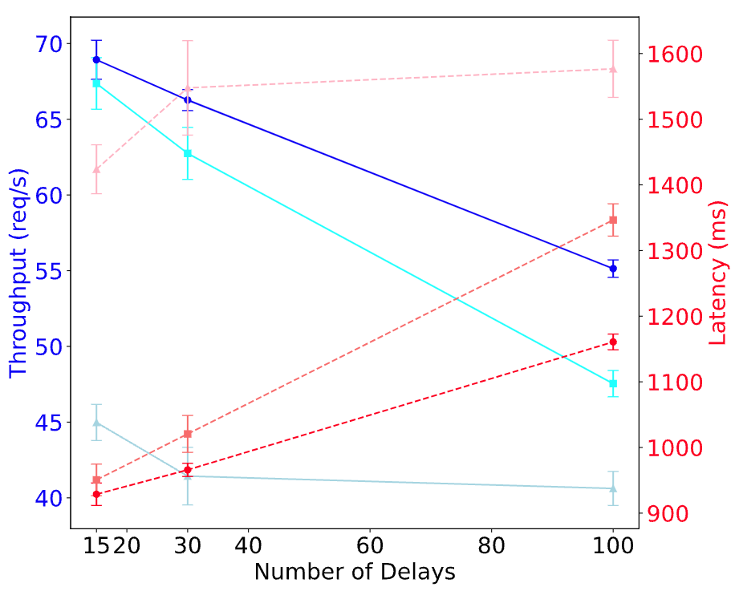
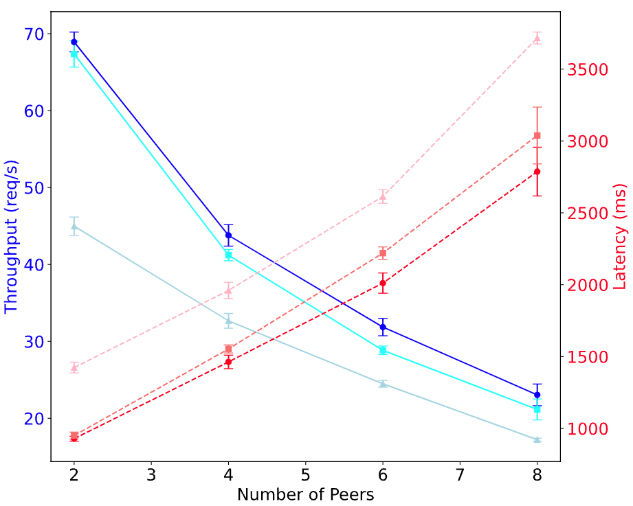
Test on different network delay (NOT SURE)
Setting
R:W = 50:50
MaxTxnPerBlock = # client
Test for different # of clients (1,2,4,8,16,32,64,128,256)
Test for different RTT delay: (15ms, 30ms, 100ms)
Test for peers = (2,4,6,8)
Observation
Native has the best performance
MTA perform just as good as Original
TLE perform the worst

Slide 52
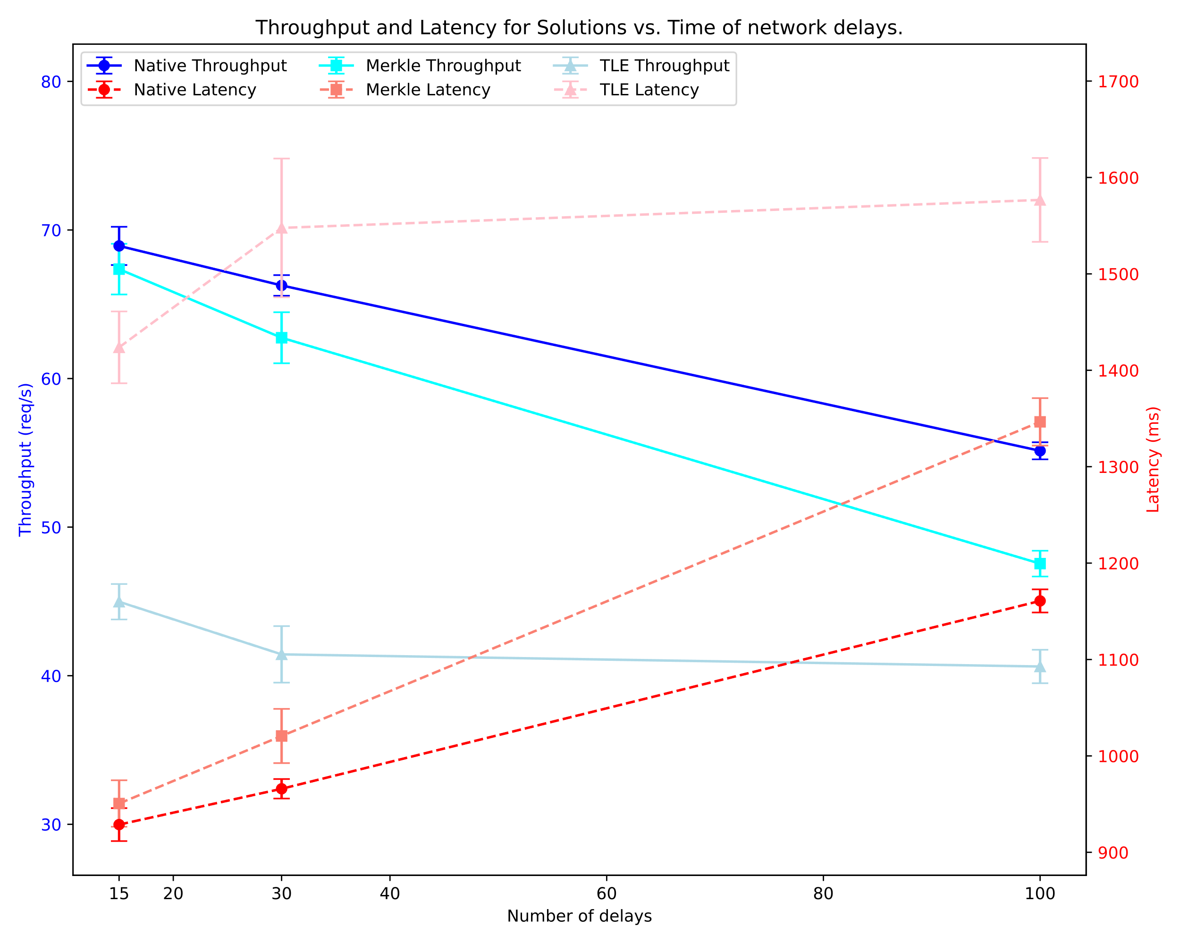
Test on different network delay
(Expectation: RTT Delay++, Latency++, MTA will become worst)
Setting
2 peers
R:W = 50:50
MaxTxnPerBlock = # client = 64
Has high throughput & small variances.
RTT delay: 15ms, 30ms, 100ms
Explain result:
Original has linear delay.
MTA has superlinear result.
Because when query merkle root we query each peer 1-by-1, should have extra 2*RTT.
TLE already slow, thus didn’t delay didn’t affect so much.

